Slide 1
Design Project 5 Single section coupled line Directional Coupler
By : Nittala Satya Surya Lakshmi Vasuki Siva Srinivas
#Id - sn620094
Email – sn620094@wne.edu

Slide 2
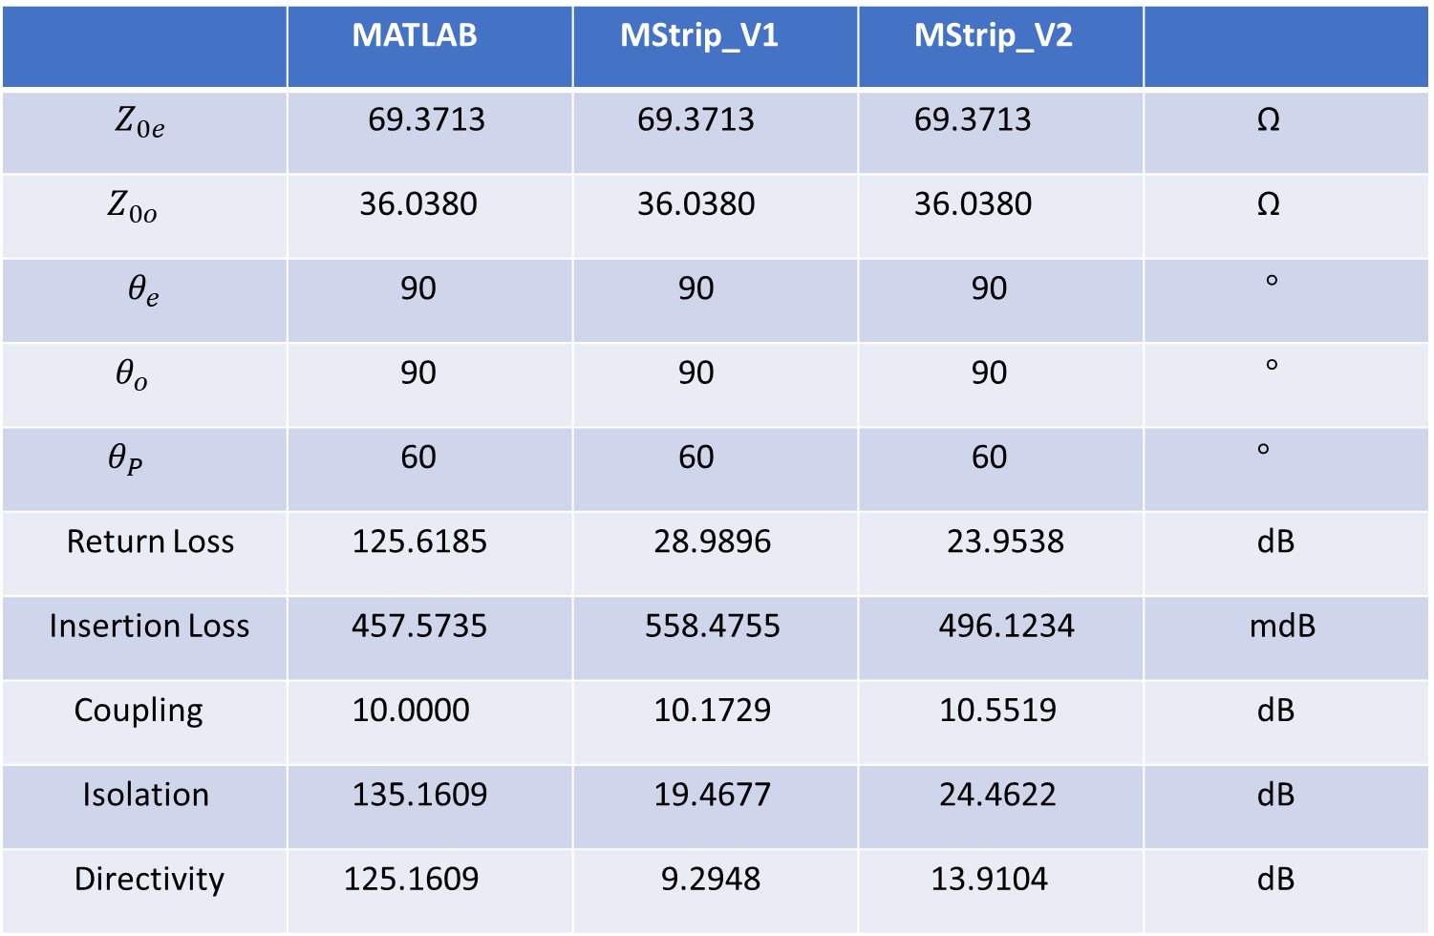
 | MATLAB | MStrip_V1 | MStrip_V2
$Z_{0e}$ | 69.3713 | 69.3713 | 69.3713 | Ω
$Z_{0o}$ | 36.0380 | 36.0380 | 36.0380 | Ω
$$θ_{e}$$ | 90 | 90 | 90 | $°$
$θ_{o}$ | 90 | 90 | 90 | $°$
$θ_{P}$ | 60 | 60 | 60 | $°$
Return Loss | 125.6185 | 28.9896 | 23.9538 | dB
Insertion Loss | 457.5735 | 558.4755 | 496.1234 | mdB
Coupling | 10.0000 | 10.1729 | 10.5519 | dB
Isolation | 135.1609 | 19.4677 | 24.4622 | dB
Directivity | 125.1609 | 9.2948 | 13.9104 | dB

Slide 3
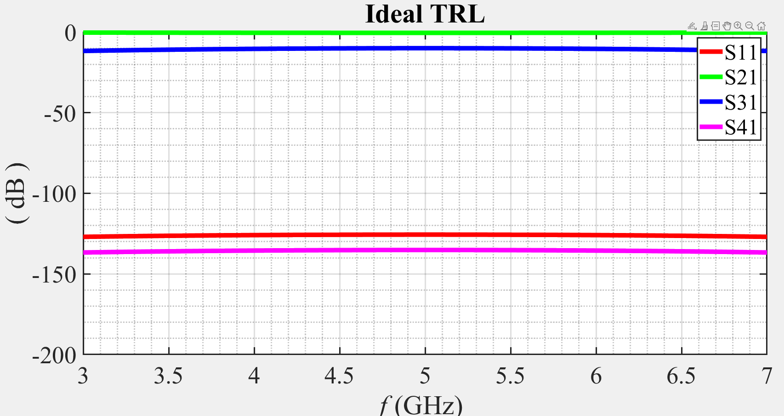
Ideal Transmission Lines

Slide 4
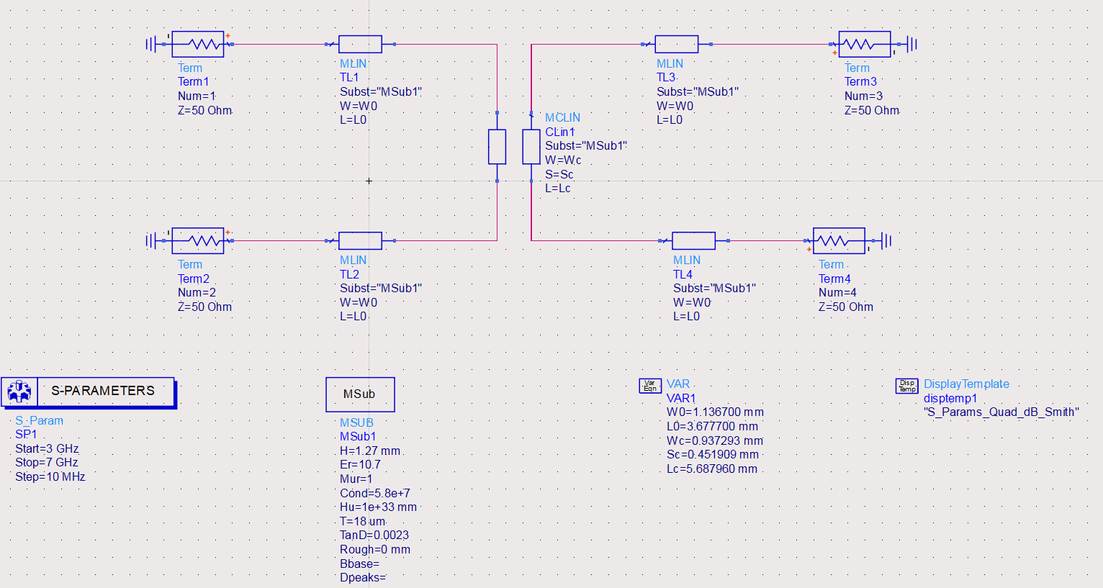
Mstrip_V1

Slide 5
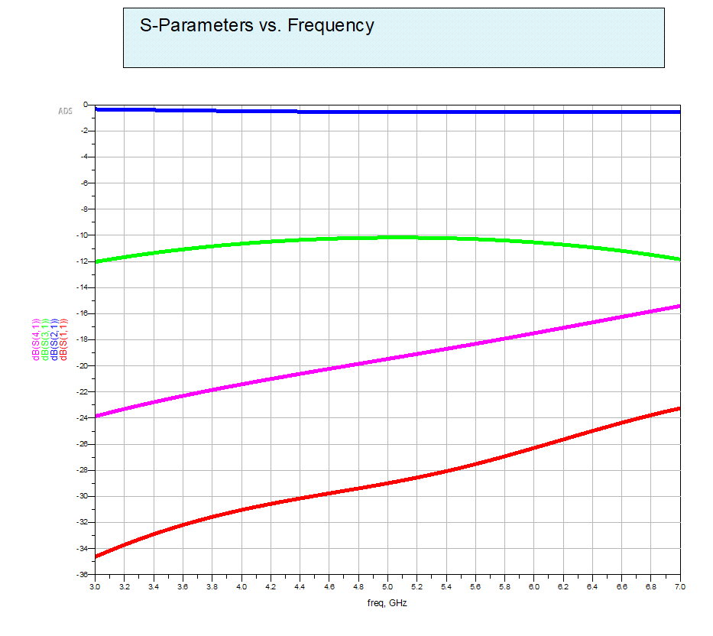
Mstrip_V1

Slide 6
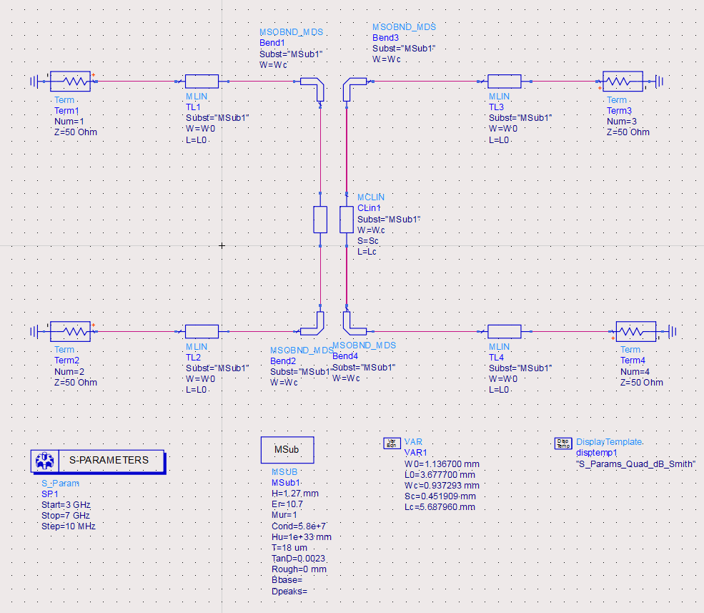
Mstrip_V2

Slide 7
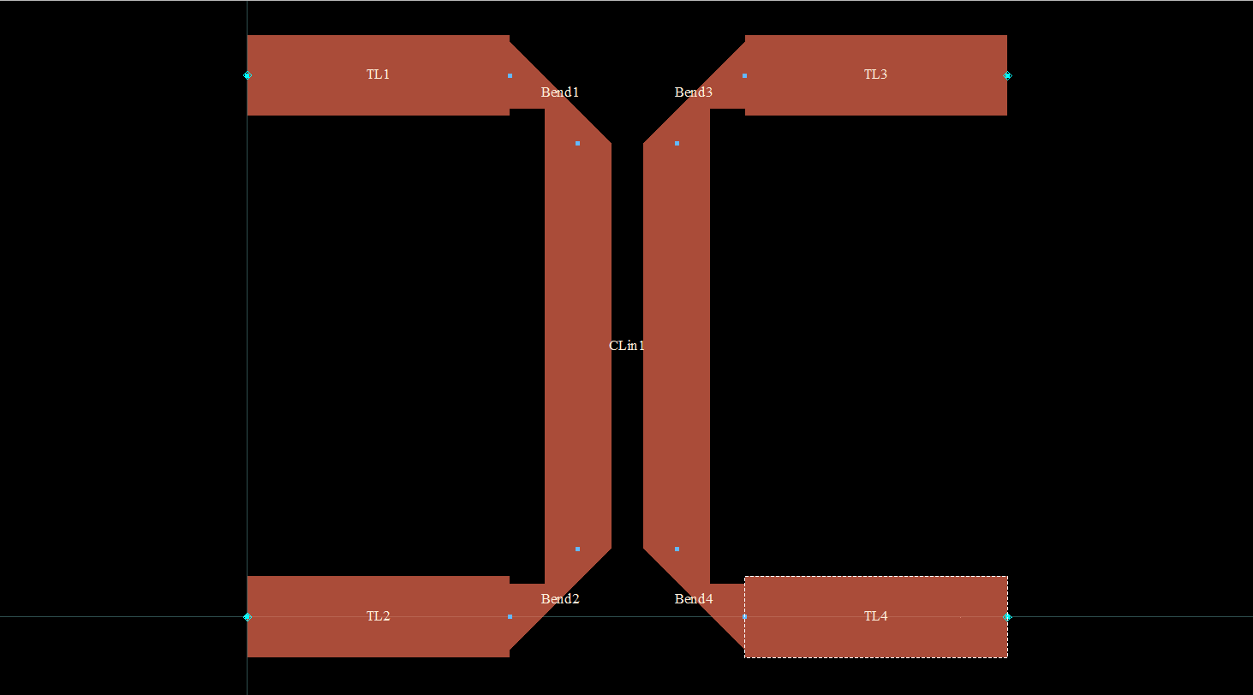
Mstrip_V2 Layout

Slide 8
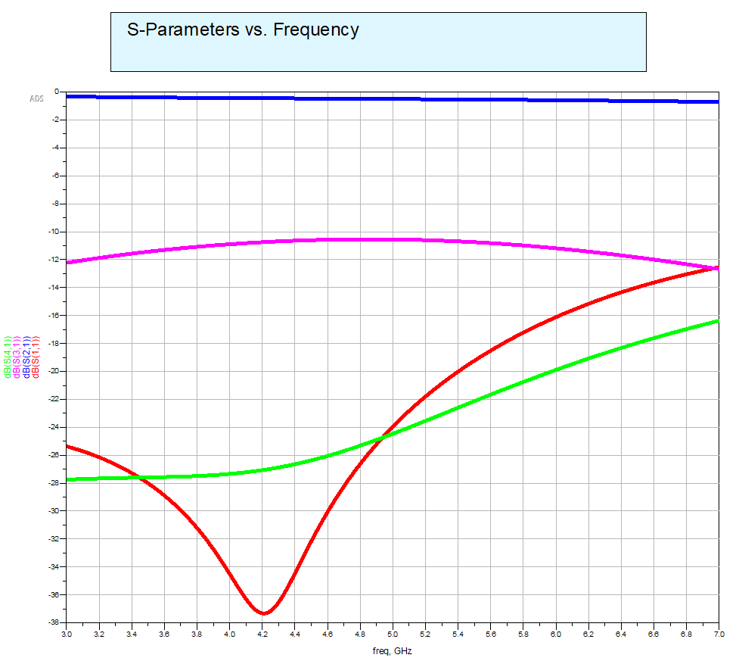
Mstrip_V2

Slide 9
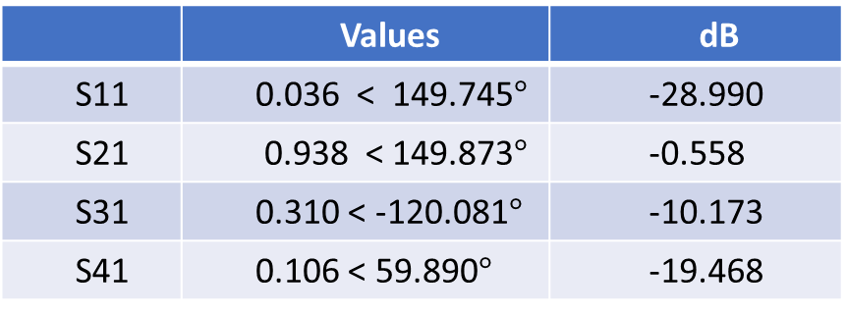
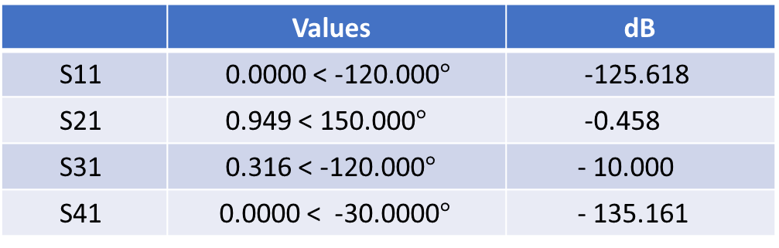
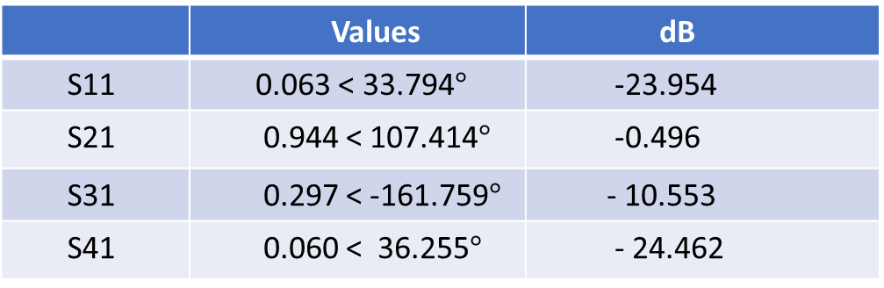
IDEAL TRANSMISSION LINES
 | Values | dB
S11 | 0.0000 < -120.000$°$ | -125.618
S21 | 0.949 < 150.000$°$ | -0.458
S31 | 0.316 < -120.000$°$ | - 10.000
S41 | 0.0000 < -30.0000$°$ | - 135.161
Mstrip_V2
 | Values | dB
S11 | 0.063 < 33.794$°$ | -23.954
S21 | 0.944 < 107.414$°$ | -0.496
S31 | 0.297 < -161.759$°$ | - 10.553
S41 | 0.060 < 36.255$°$ | - 24.462
Mstrip_V1
 | Values | dB
S11 | 0.036 < 149.745$°$ | -28.990
S21 | 0.938 < 149.873$°$ | -0.558
S31 | 0.310 < -120.081$°$ | -10.173
S41 | 0.106 < 59.890$°$ | -19.468

Slide 10
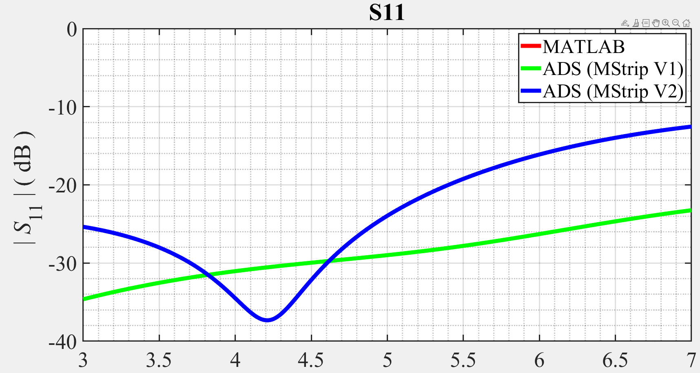

Slide 11
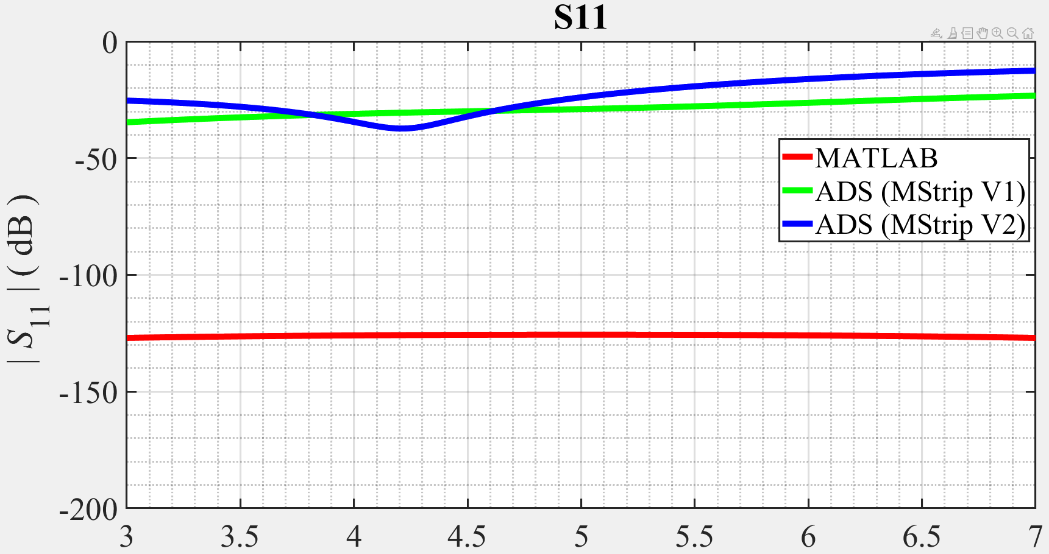
S11 plot of MATLAB, MStrip_V1 and MStrip_V2, range of 0 to -200dB

Slide 12
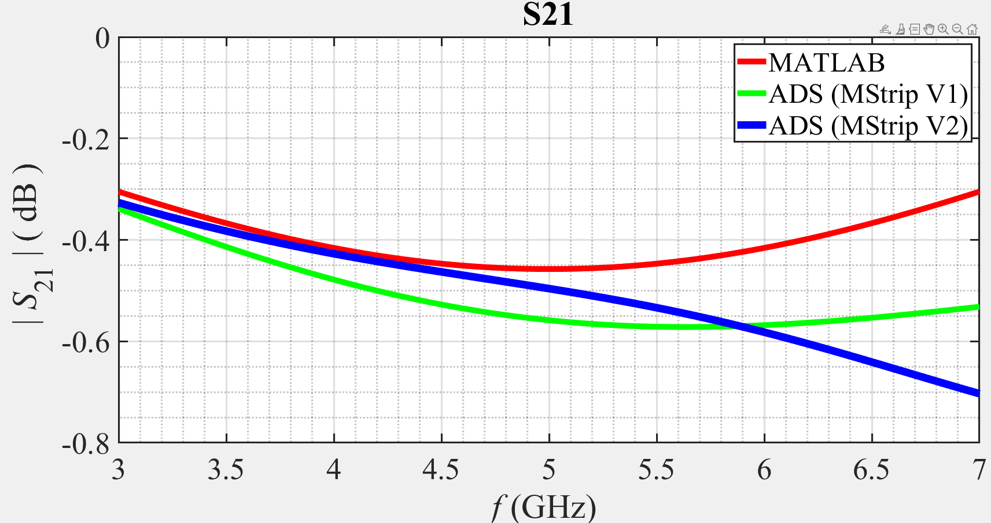

Slide 13
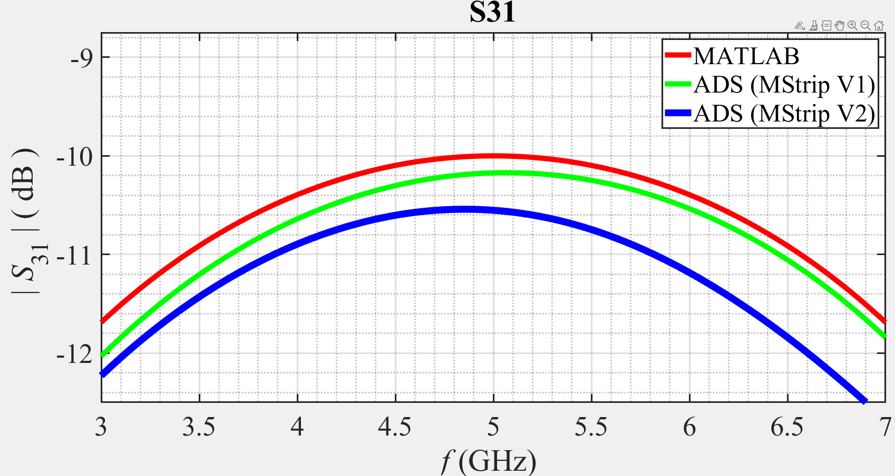

Slide 14
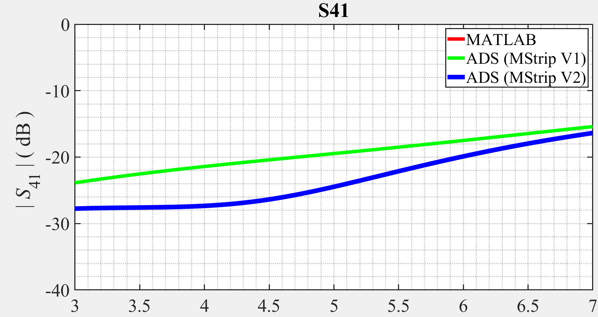

Slide 15
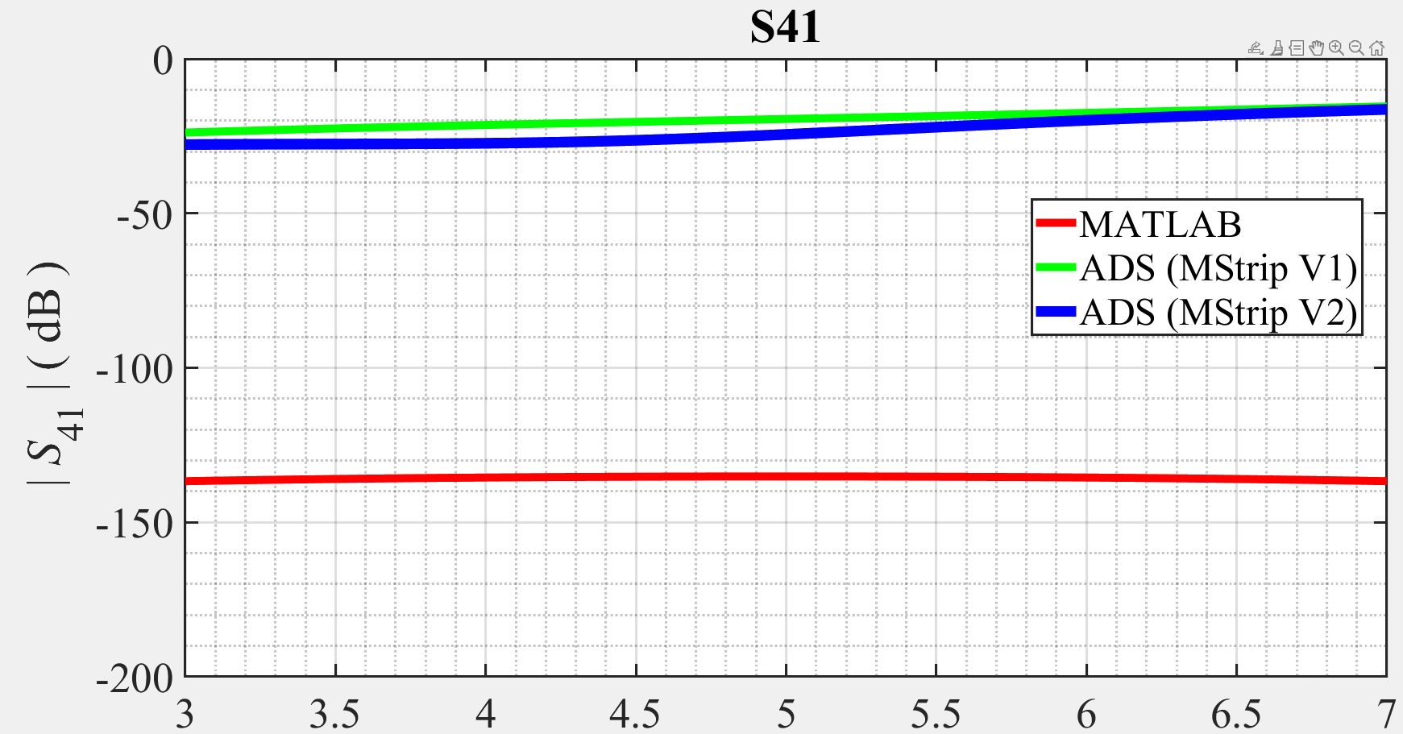
S11 plot of MATLAB, MStrip_V1 and MStrip_V2, range of 0 to -200dB

Slide 16
Appendices
MATLAB
ADS

Slide 17
The End

